Slide 1
Unit testing

Slide 2
Agenda
Testable code – Domain centric architecture
NUnit
Moq – How it works
Demo unit testing
Demo integration testing
Unit testing and Integration testing
What is TDD ?
What is Sonarcube
Q & A

Slide 3
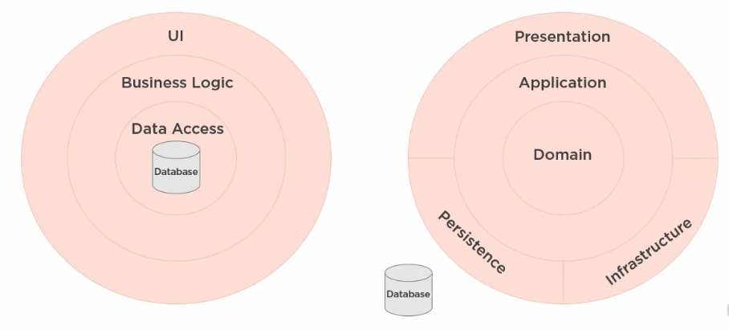
DATABASE-CENTRIC VS. Domain-centric architecture

Slide 4
Onion, CLEAN & Hexagonal arch.
https://jeffreypalermo.com/2008/07/the-onion-architecture-part-1/
https://blog.cleancoder.com/uncle-bob/2012/08/13/the-clean-architecture.html
https://alistair.cockburn.us/hexagonal+architecture

Slide 5
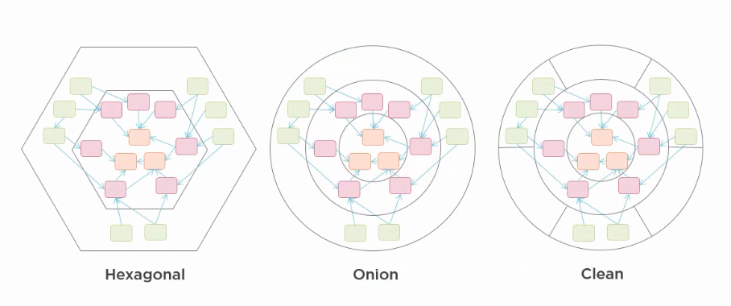
It’s all same thing
https://blog.ploeh.dk/2013/12/03/layers-onions-ports-adapters-its-all-the-same/

Slide 6
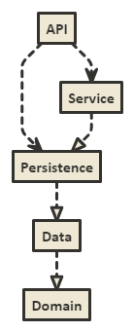

Slide 7
Project demo

Slide 8
UNIT TESTING
UNIT TESTING is a level of software testing where individual units/ components of a software are tested.
The purpose is to validate that each unit of the software performs as designed.
A unit is the smallest testable part of any software

Slide 9
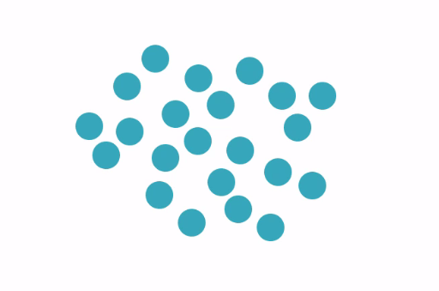

Slide 10
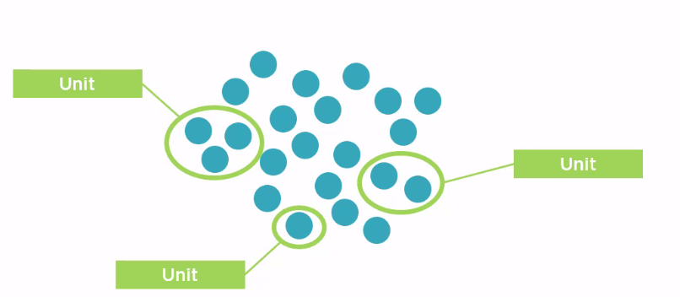

Slide 11
3 phase of unit test
Arrange
Act
Assert

Slide 12
It’s a situational thing – the team decides what makes sense to be a unit for purposes of their understanding of the system and its testing
Martin fowler
https://martinfowler.com/bliki/UnitTest.html

Slide 13
Project demo

Slide 14
Difference b/w testing lib.
 | NUnit Test | xUnit Test | MS TEST 2
Class | [TestFixture] | No | [TestClass]
Single Test Case | [Test] | [Fact] | [TestMethod]
Multi-Data | [TestCase] | [Theory] | [DataTestMethod]
 |  | [InlineData] | [DataRow]
Repeat Initialization for each Test | [SetUp] | Ctor, IDisposable | [TestInitialize]
 | [TearDown] |  | [TestCleanup]
One Time initialization for all tests in one class. | [OneTimeSetUp] | [MemberData] | [ClassInitialize]
 | [OneTimeTearDown] | Or | [ClassCleanup]
 |  | [ClassData]
 |  | Method Member (may Property Member)
One Time initialization for all tests in one assembly | Dedicated class with [SetUpFixture] + [OneTimeSetUp] [OneTimeTearDown] | [MemberData] Or [ClassData] Property Member | [TestClass] + [AssemblyInitialize] [AssemblyCleanup]

Slide 15
Mocking
Replacing actual dependency

Slide 16
Why Mock?
Reduced test complexity
Improved test execution speed
Support parallel development streams
Real dependency not yet available
Another team
Improve test predictability
Reduce testing costs

Slide 17
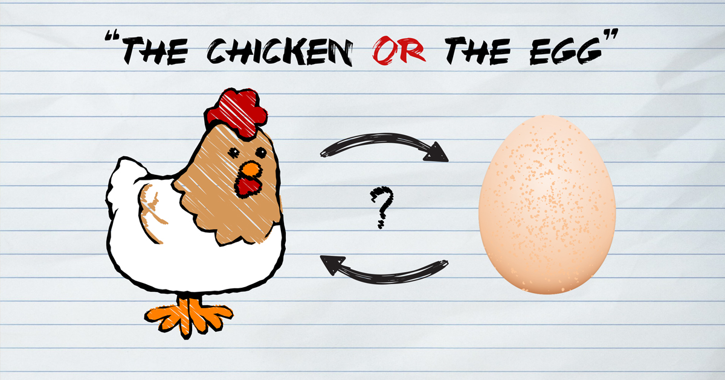
Chicken-egg problem in software development

Slide 18
Test first or code first?
It’s clean code that matters
TDD provides opportunity to create a masterpiece that proactively unbreakable and reduce time to market.

Slide 19
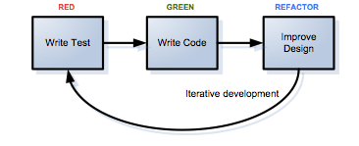
TDD is easier than I thought

Slide 20
Q&A

